Slide 1
2025 NFHS Football
Rule & Editorial Changes
Dan Donermeyer, WMFOA Rules Interpreter 6-25-25

Slide 2
Review of 2024 Changes
Rule Change 1-5-1b(3): The jerseys of the home team shall all be the same dark color(s) and clearly contrasts with white.
Editorial Change 2-32-16: Defines when a player is no longer defenseless.
Editorial Change 9-5-1g & 9-8-1j: Adds use of alcohol, tobacco or illicit substances as a noncontact UNS foul.
Editorial Change 10-4-2b: Most fouls that occur behind the LOS during loose ball plays will be enforced from the basic spot (previous spot).

Slide 3
2025 Rule Change 1-5-1-b(2)b1& 1-5-1b(3)b1
The body of the jersey shall contain only the listed allowable adornments and accessory patterns in a color(s) that contrasts to white: (1) as the jersey number(s), required in 1-5-1(c ) or as the school’s nickname, school logo, school mascot, school name and/or player name within the body and/or on the shoulders.

Slide 4
2025 Rule Change 1-5-1-d(5) a 4 & 5
A single tooth and mouth protector (intraoral) which shall:
(4) not include any attachment(s) that do not serve a purpose and function in protecting teeth or mouth (effective 2026; and
(5) not include anything on it that is a health or risk issue and can pose a danger to themselves or other players (effective 2026)

Slide 5
2025 Rule Change 1-5-2-d
Effective 2027, arm sleeves, whether attached to a shirt or unattached, manufactured to enhance contact with the football or opponent must meet SFIA Specification at the time of manufacturing. Arm sleeves must have a permanent exact replica of the SFIA arm sleeve seal (meets SFIA Specification) that must be visible and appear legibly on the exterior of the arm sleeve.

Slide 6
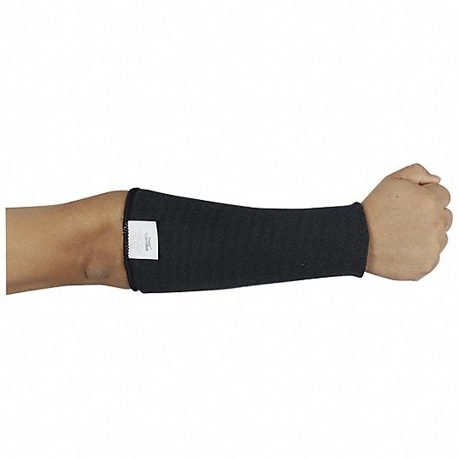

Slide 7
2025 Rule Change 1-5-3-c 2, 3 & 6
The following Other Illegal Equipment:
(2) Except during an outside 9-yard mark conference, electronic audio or non-fixed video communication devices used to communicate with a player.
(3) Any audio (microphone) or video (camera) device worn by a player during the game.
(6) Jerseys, undershirts or exterior arm covers/pads manufactured to enhance contact with the football or opponent (through 2026. Effective 2027, jerseys or pads manufactured to enhance contact with the football or opponent.

Slide 8
2025 Rule Change 3-4-2(d) & 4-3-1 EXCEPTION
The game clock shall start with the ready for play on a down beginning with the snap if the game clock was stopped for any reason other than specified in Rule 3-4-3 or an untimed down: d. Team A forward fumble out of bounds.
4-3-1 Exc: When a forward fumble goes out of bounds or is ruled out of bounds between goal lines, the ball shall be returned to the spot of the fumble.

Slide 9
2025 Rule Change 9-6 Penalty
10-4-4-b for penalty enforcement for illegal participation has been deleted. Last year, the penalties under 9-6-4b-f (of which this rule references) were enforced from the previous spot. Now, all penalties for illegal participation will be 15 yard live ball penalties enforced from the basic spot.

Slide 10
2025 Editorial Change 2-32-16 & 9-4-3-9
The following was moved from Rule 2 to Rule 9 regarding a defenseless receiver:
Initiate forceful contact against a defenseless receiver as in 2-32-16b and 2-32-16c that is not:
1. Incidental contact as a result of making a play on the ball;
2. Initiated with open hands;
3. An attempt to tackle by wrapping arm(s) around the receiver.

Slide 11
2025 Editorial Change 2-41-9 (c )
The spot where a run ends: c: The spot of the catch or recovery when the momentum exception as in 8-5-2a EXCEPTION is in effect (This includes a fumble that goes from the end zone into the field of play and out of bounds).

Slide 12
2025 Editorial Change 6-1-9
The 4 penalty options for a kick out of bounds between goal lines have been removed as they are listed in the penalty section for this rule.

Slide 13
2025 Editorial Change 7-2-5-b-2
On fourth down or during a kick try, when A sets or shifts into a scrimmage kick formation, any A player numbered 0 to 49 or 80 to 99 may take the position of any A player numbered 50 to 79. A player in the game under this exception must assume an initial position on his line of scrimmage between the ends and he remains an ineligible forward pass receiver during that down unless the pass is touched by B. Once the snapper puts his hands on the ball, players on the line of scrimmage and in between the ends are ineligible and remain ineligible.

Slide 14
2025 Editorial Change 9-5-1(g) & 9-8-1(j)
This is in reference to the use of alcohol, tobacco or illicit substances as a noncontact UNS foul. The word “contest” has been replaced with the word “game”.

